Slide 1

Chapter 5
Abstraction and Interfaces
ITP03 | 1ST SEMESTER

Slide 2
Learning Objectives
Understand the concept and purpose of abstraction in OOP.
Declare and implement abstract classes and methods in PHP.
Define interfaces and implement them in classes.
Differentiate between abstract classes and interfaces.
Apply abstraction and interfaces in real-world scenarios.

Slide 3
What is Abstraction?
Abstraction hides unnecessary details and shows only the essential features.
It focuses on what an object does, not how it does it.
Achieved using abstract classes or interfaces.
Can declared attributes
May contain
-Normal methods (with body)
-Abstract methods (without body, must be implemented in child classes)

Slide 4
Purpose of Abstract Classes
Template for Subclasses
Defines a base structure, leaving details to subclasses.
Enforcing Method Implementation
Child classes must implement abstract methods.
Promotes code consistency across subclasses.

Slide 5
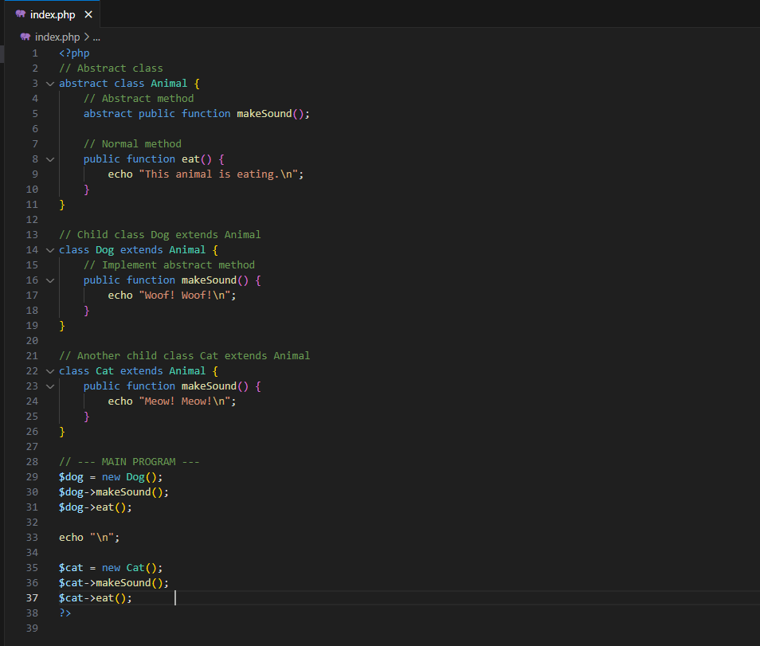
Syntax using Abstract
Notes:
<?php
// Abstract class
abstract class Animal {
protected $name;
// Constructor with body
public function __construct($name) {
$this->name = $name;
}
// Abstract method (must be implemented by child)
abstract public function makeSound();
// Normal method (shared by all animals)
public function eat() {
echo $this->name . " is eating.\n";
}
}
// Dog extends Animal
class Dog extends Animal {
public function makeSound() {
echo $this->name . " says: Woof! Woof!\n";
}
}
// Cat extends Animal
class Cat extends Animal {
public function makeSound() {
echo $this->name . " says: Meow! Meow!\n";
}
}
// --- MAIN PROGRAM ---
$dog = new Dog("Buddy");
$dog->makeSound(); // Buddy says: Woof! Woof!
$dog->eat(); // Buddy is eating.
echo "\n";
$cat = new Cat("Melody");
$cat->makeSound(); // Melody says: Meow! Meow!
$cat->eat(); // Melody is eating.
?>

Slide 6
Purpose of Interfaces Classes
Defined with the interface keyword.
Only contains method signatures (no implementation or body).
A class that implements an interface must provide all methods.
Supports multiple interface implementation (unlike classes).

Slide 7
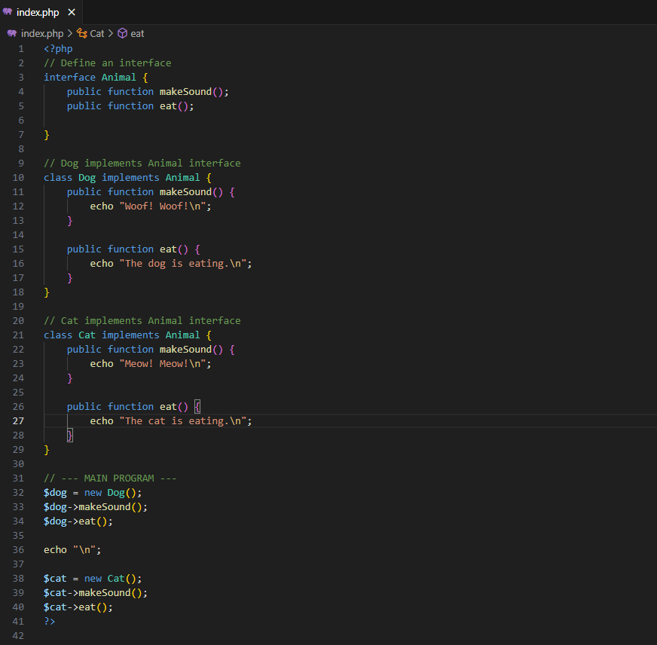
Syntax using Interfaces
Notes:
<?php
// Define an interface
interface Animal {
public function makeSound();
public function eat();
public function __construct($name);
}
// Dog implements Animal interface
class Dog implements Animal {
private $name;
public function __construct($name){
$this->name = $name;
}
public function makeSound() {
echo $this->name . " says: Woof! Woof!\n";
}
public function eat() {
echo $this->name . " is eating dog food.\n";
}
}
// Cat implements Animal interface
class Cat implements Animal {
private $name;
public function __construct($name){
$this->name = $name;
}
public function makeSound() {
echo $this->name . " says: Meow! Meow!\n";
}
public function eat() {
echo $this->name . " is eating cat food.\n";
}
}
// --- MAIN PROGRAM ---
$dog = new Dog("Buddy");
$dog->makeSound(); // Buddy says: Woof! Woof!
$dog->eat(); // Buddy is eating dog food.
echo "\n";
$cat = new Cat("Melody");
$cat->makeSound(); // Melody says: Meow! Meow!
$cat->eat(); // Melody is eating cat food.
?>

